Slide 1

Model Development

Slide 2
Objectives
Describe how to process linear regression in Python
Apply model evaluation using visualization in Python
Model Development

Slide 3
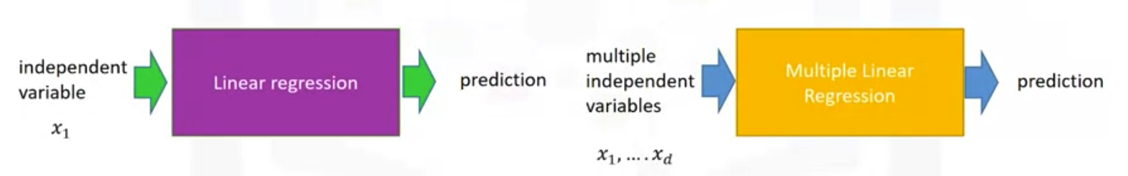
Linear and Multiple Linear Regression
Linear regression will refer to one independent variable to make a prediction.
Multiple linear regression will refer to multiple independent variables to make a prediction.
Model Development

Slide 4
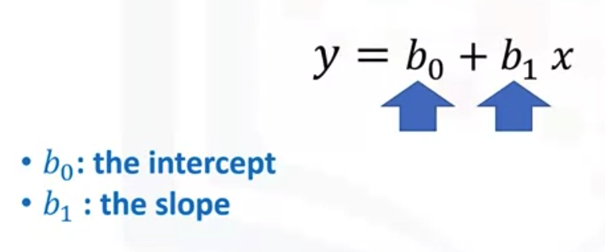
Linear and Multiple Linear Regression
Simple Linear Regression- SLR
  Understand the relationship between two variables.
  The predictor independent variable x
  The target dependent variable y.
Model Development

Slide 5
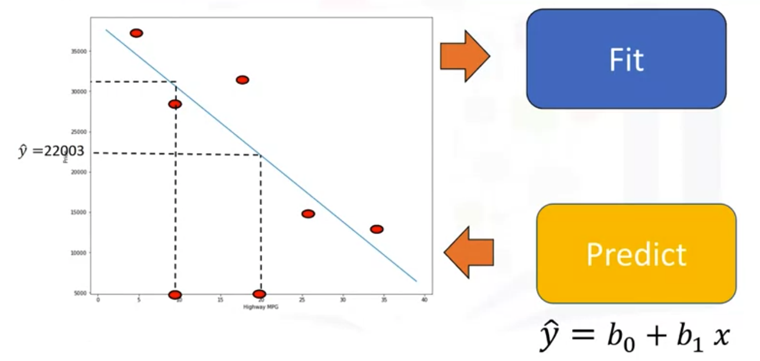
Linear and Multiple Linear Regression
Model Development

Slide 6
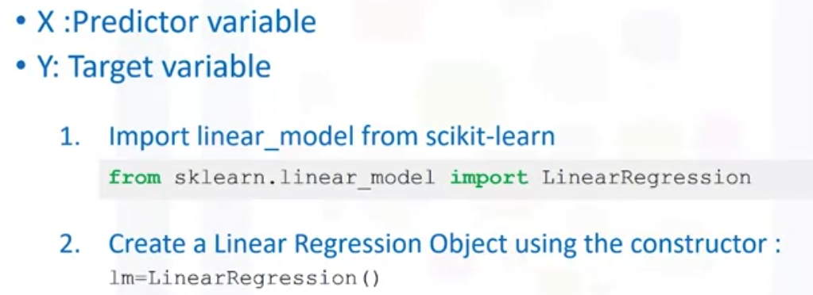
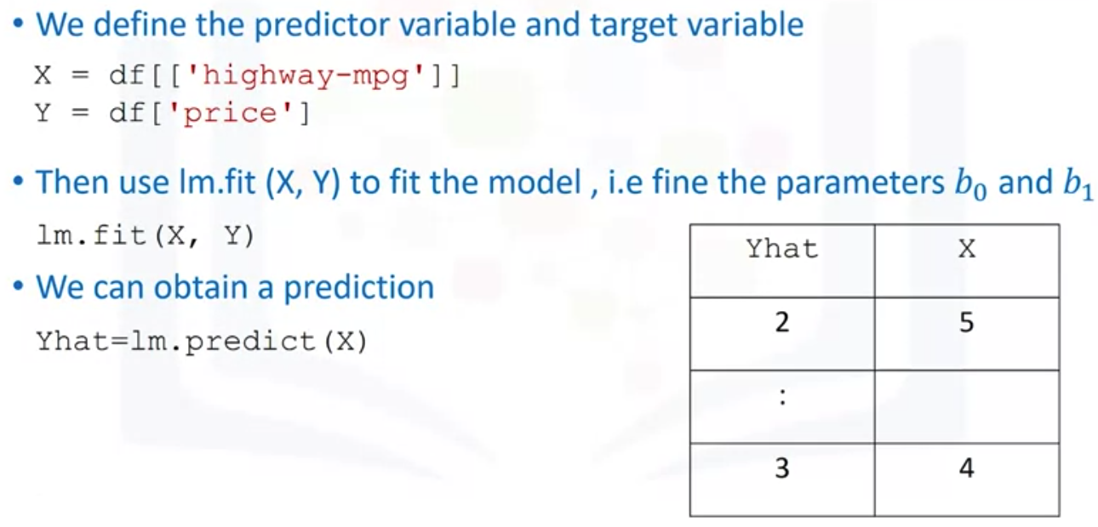
Linear and Multiple Linear Regression
Model Development

Slide 7
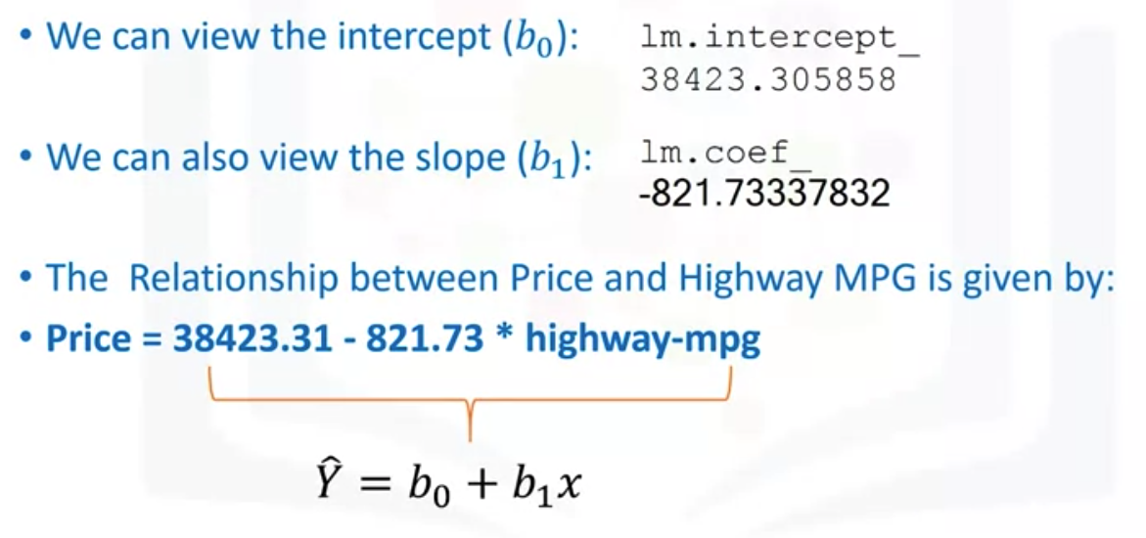
Linear and Multiple Linear Regression
kkkkk
Model Development

Slide 8
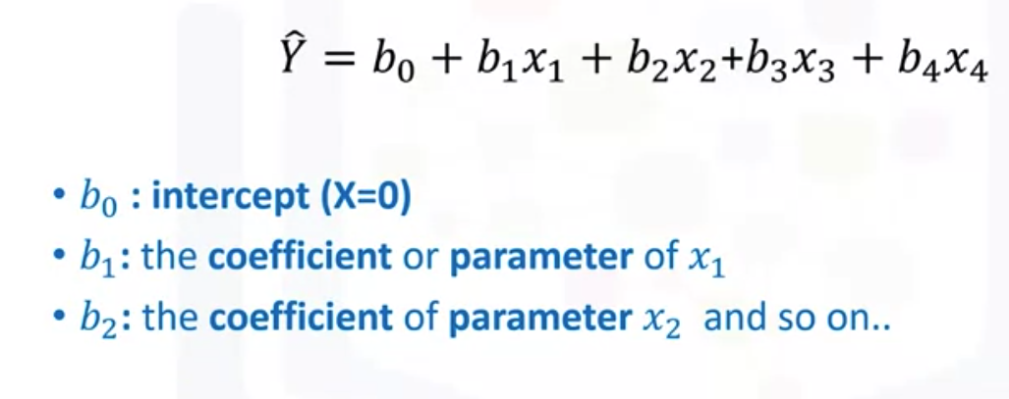
Linear and Multiple Linear Regression
Multiple linear Regression( MLR)
  One contimous target( Y) variable
  Two or more predictor (X) variables
Model Development

Slide 9
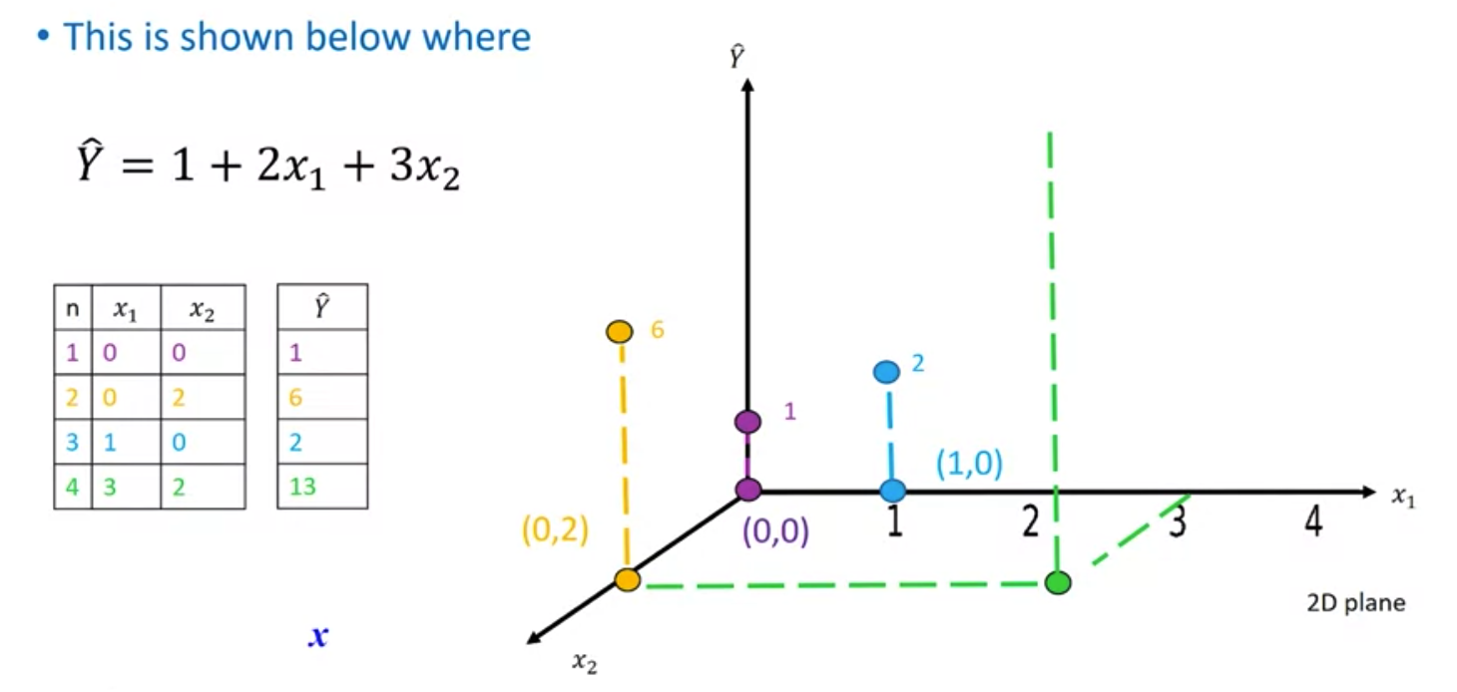

Linear and Multiple Linear Regression
Model Development

Slide 10
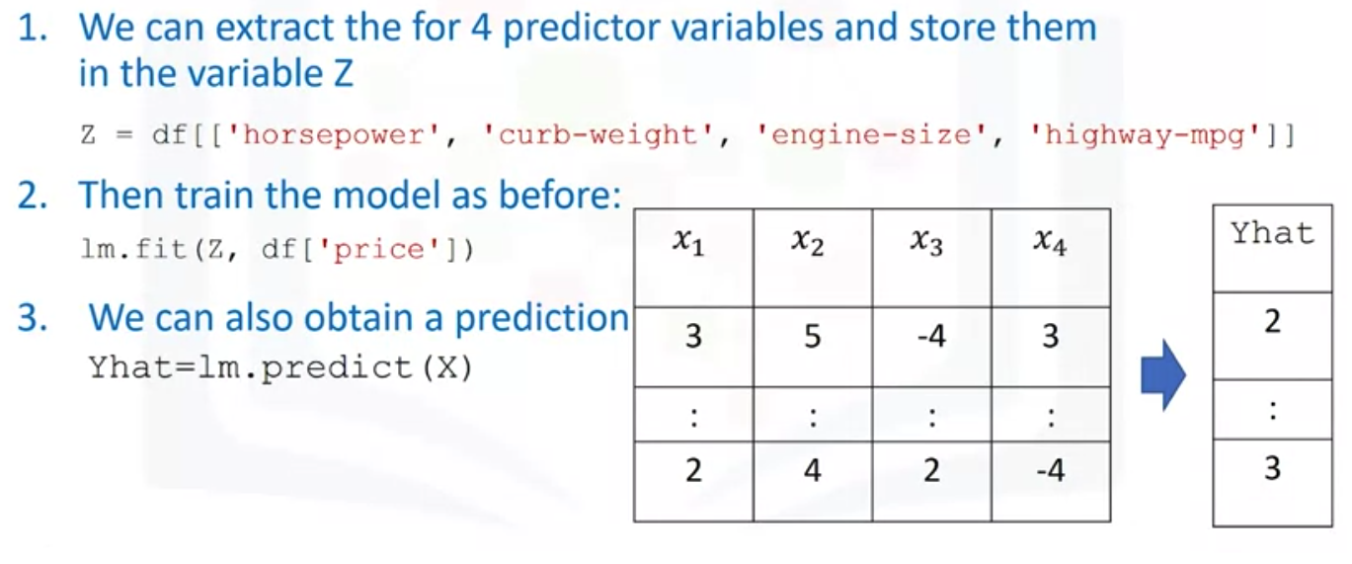
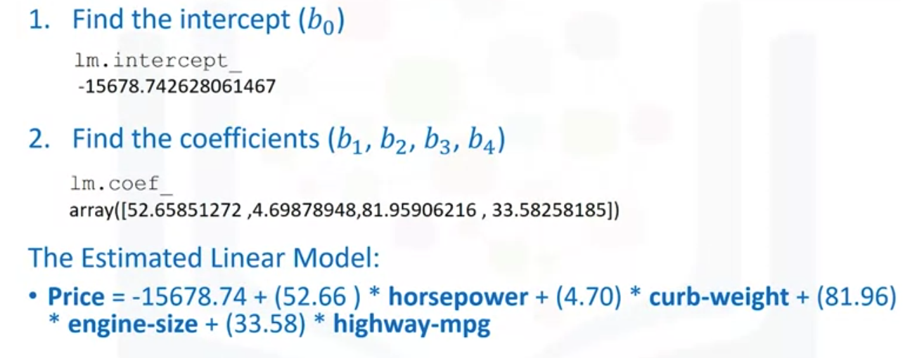
Linear and Multiple Linear Regression
Model Development

Slide 11
Linear and Multiple Linear Regression
Regression plots are a good estimate of the relationship between two variables, the strength of the correlation, and the direction of the relationship (positive or negative).
The horizontal axis is the independent variable.
The vertical axis is the dependent variable.
Each point represents a different target point.
The fitted line represents the predicted value.
Model Development

Slide 12
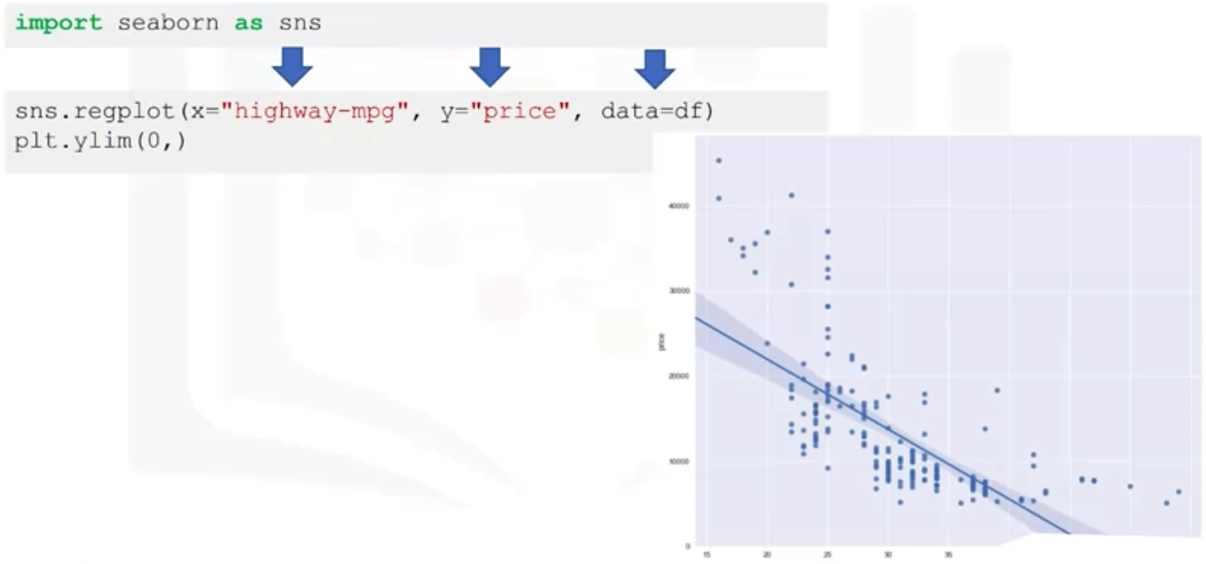
Model Evaluation using Visualization
Regression Plot
Model Development

Slide 13
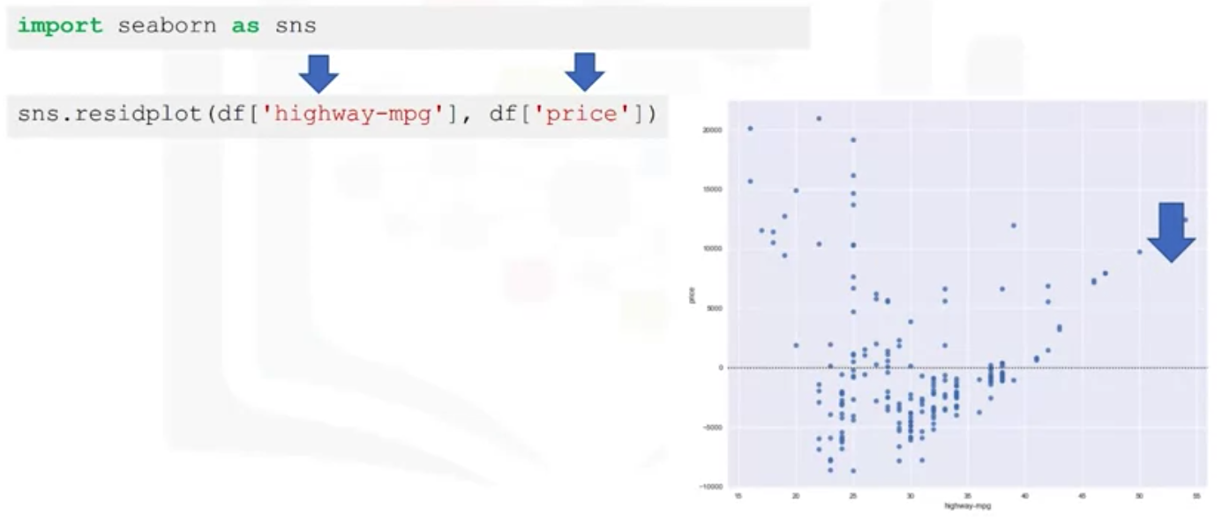
Model Evaluation using Visualization
Residual Plot
Model Development

Slide 14
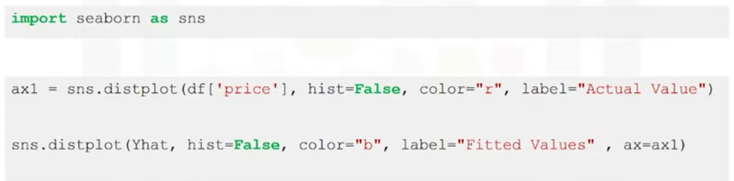
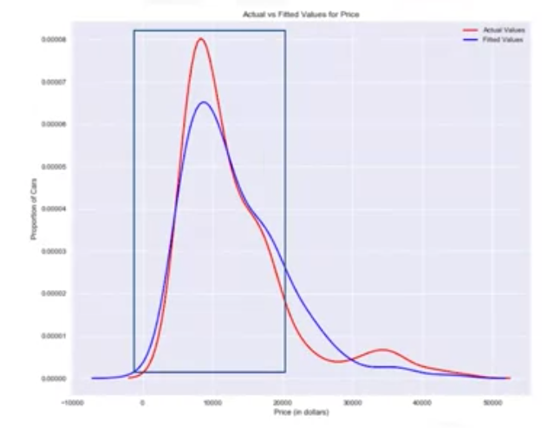
Model Evaluation using Visualization
Distribution Plot
Model Development

Slide 15
Summary
Describe how to process linear regression in Python
Apply model evaluation using visualization in Python
Model Development

Slide 16
Q & A
Model Development

